Slide 1

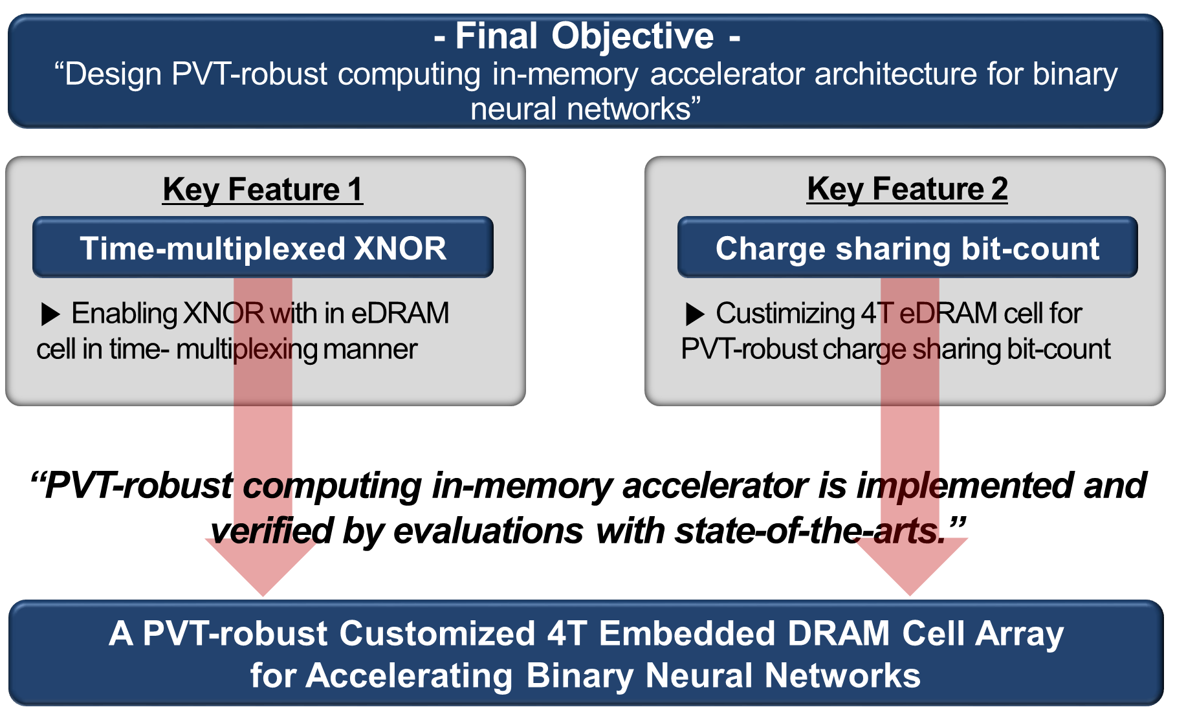
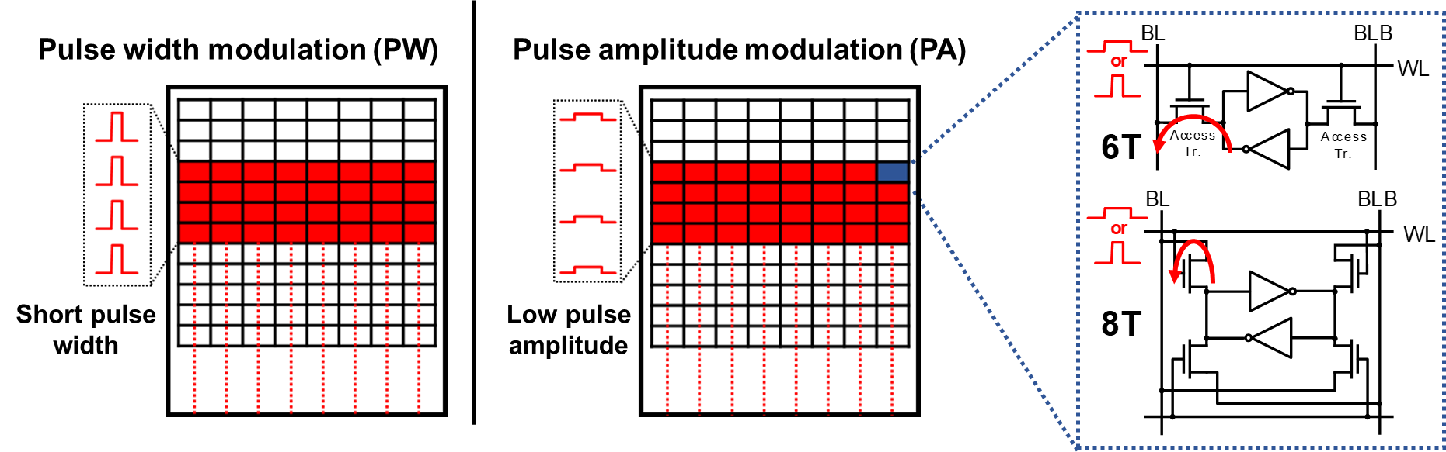
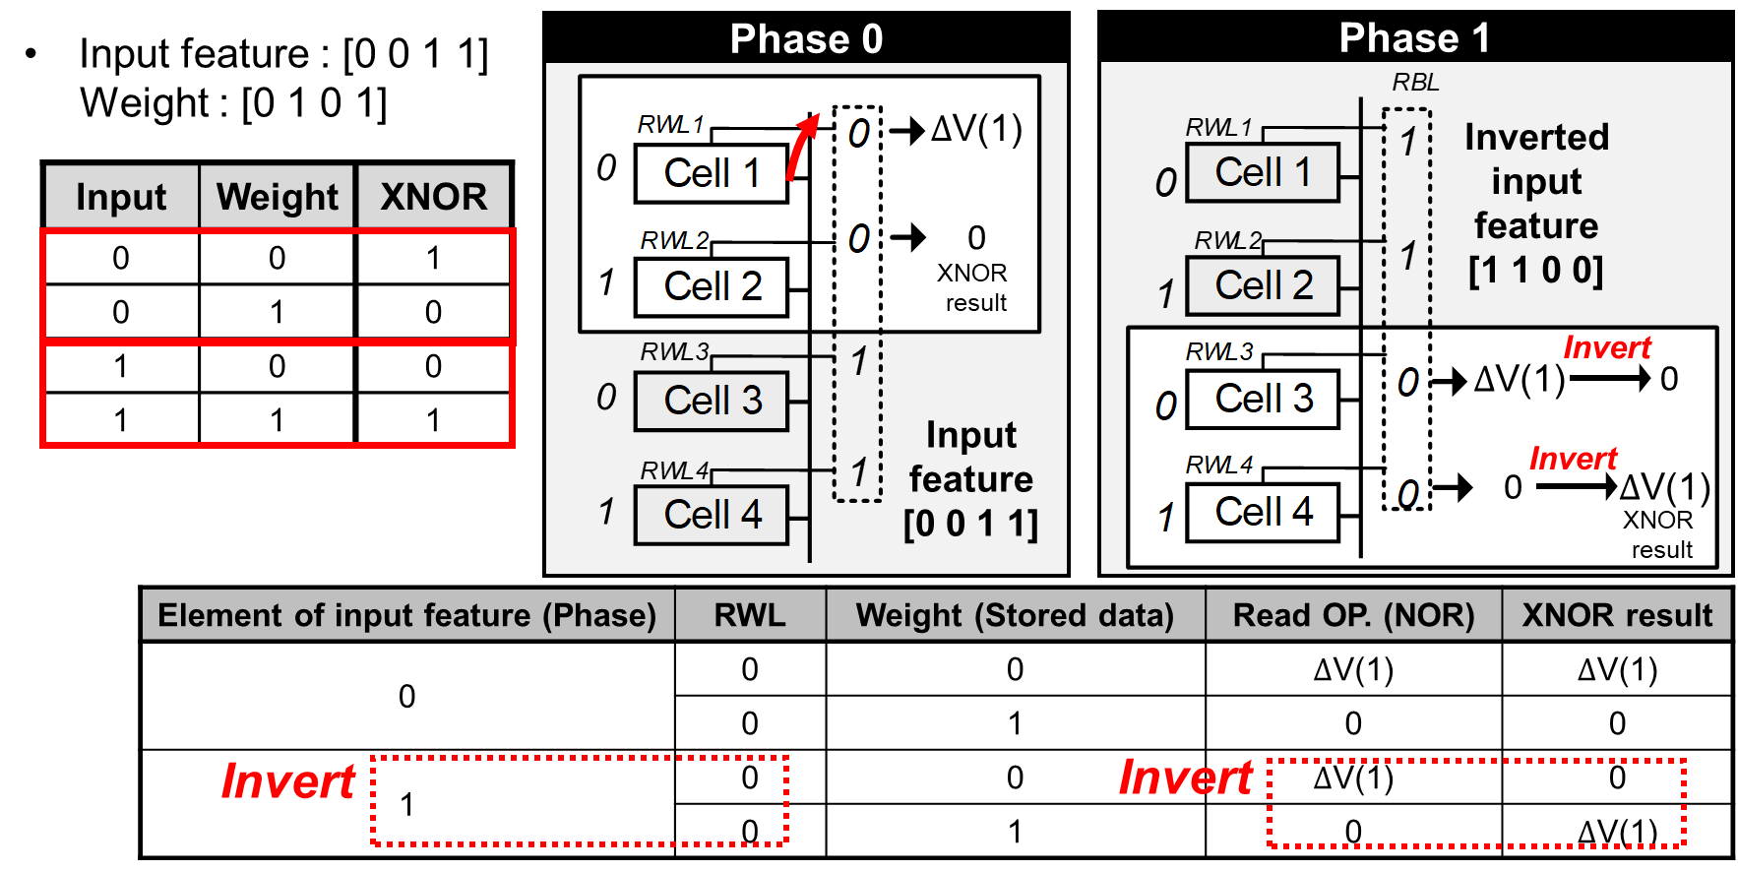
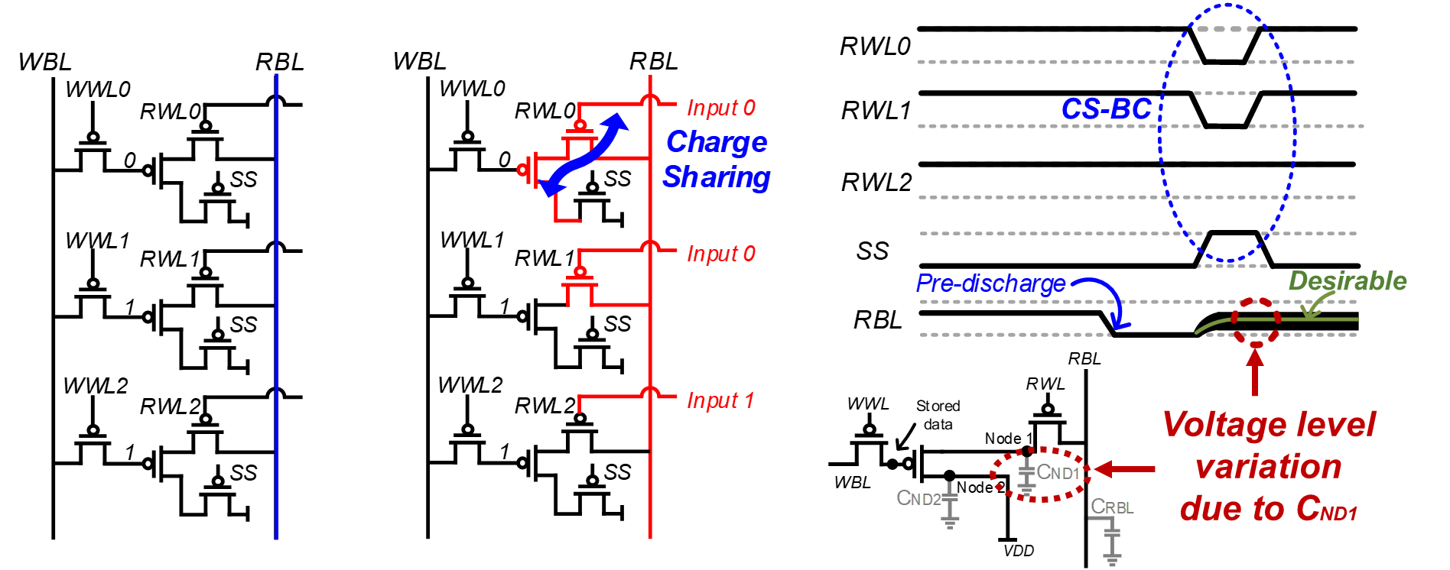
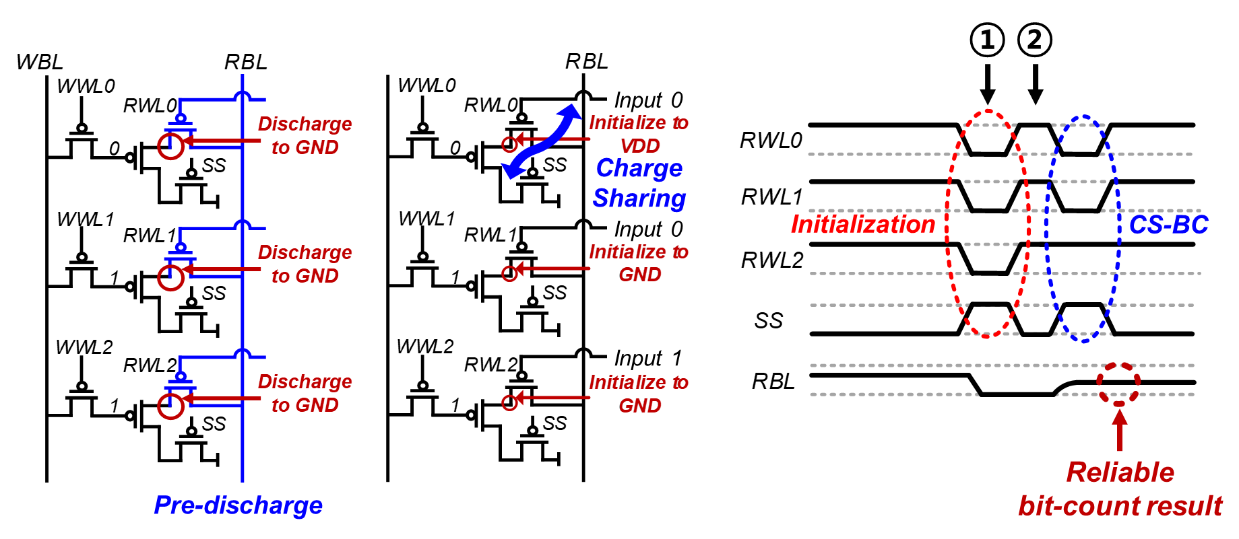
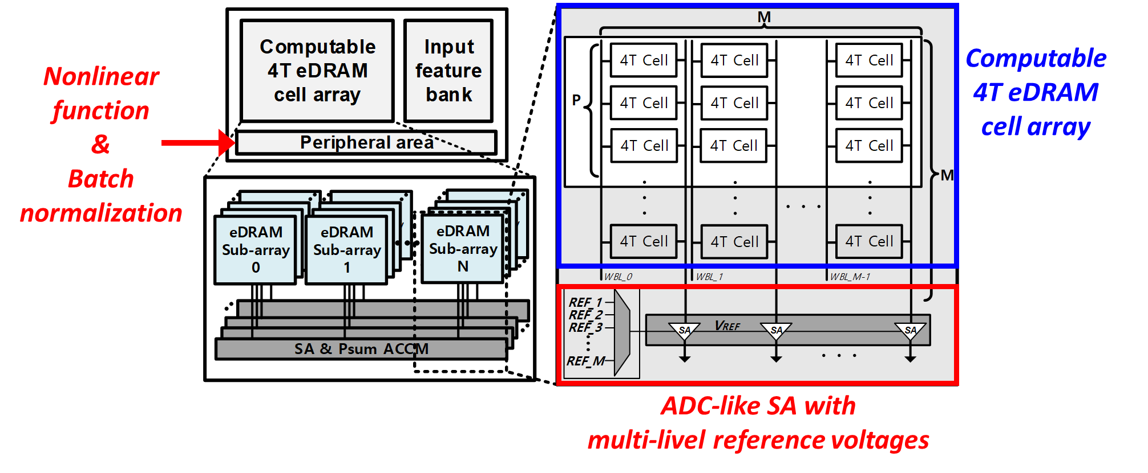
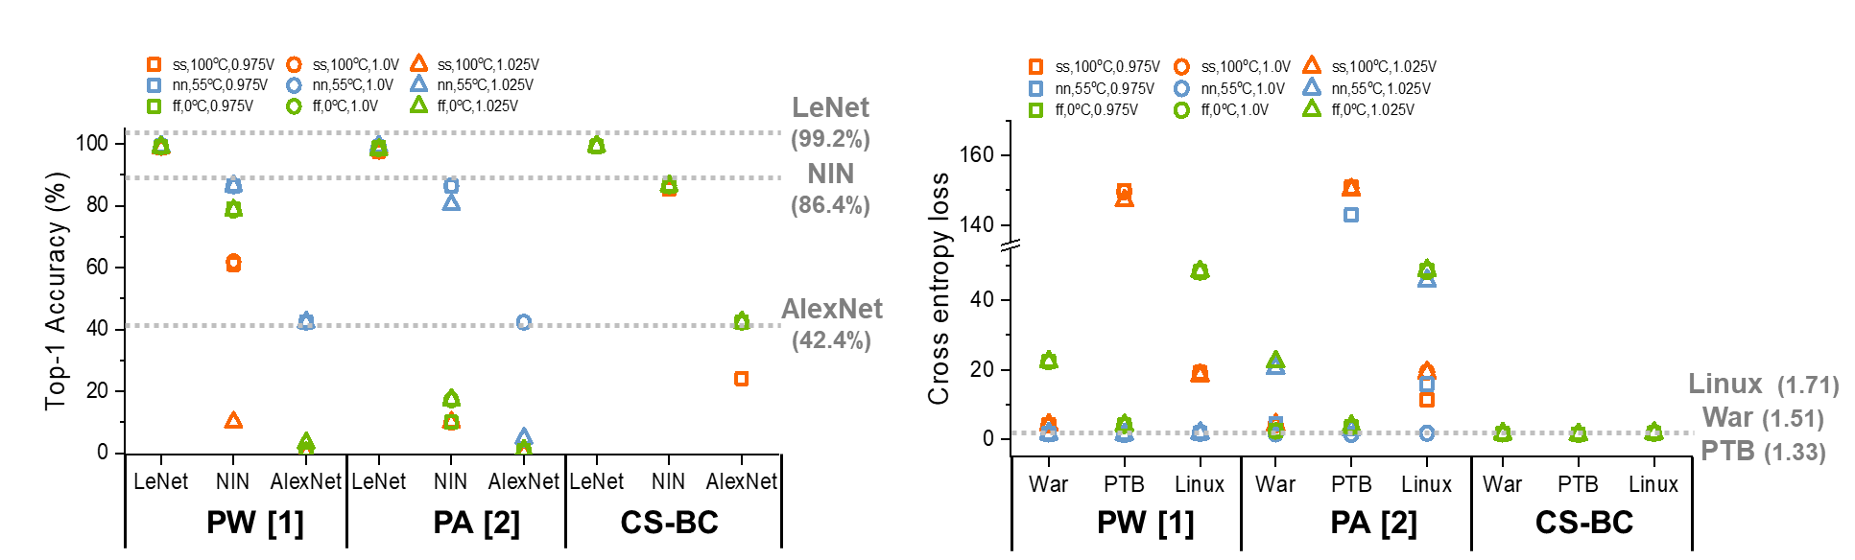


A PVT-robust Customized 4T Embedded DRAM Cell Array for Accelerating Binary Neural Networks
Hyein Shin, Jaehyeong Sim, Daewoong Lee, and Lee-Sup Kim
Multimedia VLSI Lab, School of Electrical Engineering, KAIST
※ The chip fabrication was supported by the IC Design Education Center(IDEC), Korea.
Problem definition
Overview
Computing in-memory is promising solution for memory wall problem.
Previous CIN architectures are vulnerable to PVT variation due to pulse modulation approach.
Time-multiplexed XNOR in eDRAM
Charge sharing based bit-count
Without
initialization
There exists non-ideality in the bit-count results due to C_{ND1}.
Custumized 4T eDRAM cell
With
initialization
In the TM-XNOR, weights of BNN are stored in the eDRAM cell and elements of an input feature are applied to RWLs.
In phase 1, the XNOR operations with the value of “1” elements in input features are performed over 2 steps unlike phase 0.
With the initialization, reliable bit-count results are obtained.
Overall architecture
Evaluation
Pulse width (PW) modulation [1]
Pulse amplitude (PA) modulation [2]
Proposed CS-BC
The proposed CS-BC shows robust performance regardless of PVT variation compared to previous works.
Binary dot product is performed in computable 4T eDRAM cell array and bit-count results are converted to digital value by ADC-like SAs.
Nonlinear functions and batch normalization operations are performed in the peripheral area of eDRAM array.
Our architecture supports 8bit binary dot product per column at each cycle.
Previous approaches [1,2] show severe accuracy loss on various benchmarks.
Our CS-BC shows no accuracy degradation except for the case of ss/100°c/0.95V.
[1] “A Multi-functional In-memory Inference Processor Using a Standard 6T SRAM Array”, M. Kang et al., JSSC 2018.
[2] “Parallelizing SRAM Arrays with Customized Bit-Cell for Binary Neural Networks.”, R. Liu et al., DAC 2018.
Multimedia
VLSI Lab.
2020 IDEC Congress CDC

